Slide 1

Movie Studio Investment Analysis.
Wamuyu Gitonga, Lilian Wangui, Natalie Wanjiku, John Njogu, Leejay Mwakireti, Vanessa Sandra.

Slide 2
Agenda.
Introduction.
Business understanding.
Data understanding.
Methods.
Recommendations.
Q & A.
Conclusion.

Slide 3
Introduction.
Unlocking new horizons.

Slide 4
Overview.
The company, looking to diversify its portfolio, has identified the film industry as a potential profitable business opportunity.
In this presentation, we will be reviewing areas in the film industry the company ought to focus on in order to drive profits as they embark on this exciting journey.

Slide 5

Business understanding.
Understanding what the industry entails.

Slide 6
Business overview.
The film industry business involves understanding how films are developed, financed, produced, distributed and monetized.
In order to make informed decisions on those areas, we are going to explore the types of films currently doing well, and let our findings guide our decisions.
1.
2.
Revenue streams
3.
Key players
4.
Trends and challenges
Film industry value chain
6

Slide 7
Business objectives.
Maximize revenue and profitability.
Optimize cost-efficiency during production.
Achieve strong ROI for investors and stakeholders.
Own valuable Intellectual Property.
Create original or franchise-worthy content.
Build strong brand and audience loyalty.
Establish production labels.
Foster community engagement through fan engagements.
Attract and retain talent.
Work with reputable actors, directors and writers.

Slide 8
Data understanding.
Description of the data used in the project.

Slide 9

Data.
The project used data from 4 different sources, namely;
Internet Movie Database (IMDB).
The Movie DB (TMDB).
Box Office Mojo (BOM).
The Numbers (TN).
f
9

Slide 10
Data description.
The IMDB and TMDB databases contain general movie descriptions including their production crews and their biographies, movie ratings, and fan and critical reviews etc.
The TN and BOM datasets contain tracked systematic and algorithmic domestic and foreign box office revenues.
10

Slide 11
Methods.
Analysis methods used in the project.

Slide 12
Approach.
Content analysis.
The team examined the contents of the data for pattern identification and, analyzed the behavior of each column over specific periods of time.
Drill-down analysis.
We also explored the datasets at an increased level of detail to understand the patterns we observed.
Prescriptive analysis.
Post drill-down analysis, we made recommendations based on the analysis findings.

Slide 13

Recommendations.
Our future.

Slide 14
Genre recommendations.
Portfolio strategies: Balance & Diversity.
We strongly recommend that the company focus on highly profitable genres that do well even on lower production budgets as well as balance high-profit, high-budget genres. However, we caution that not all blockbuster films succeed therefore we counsel that you consider making only 1/2 blockbuster movies per year while balancing smaller projects.
Genre type | Purpose
Animation / Horror / Documentary/ Thriller | Stable cash flow, lower budget
Action / Adventure / Sci-Fi/ Fantasy | Big-brand building, potential blockbusters

Slide 15
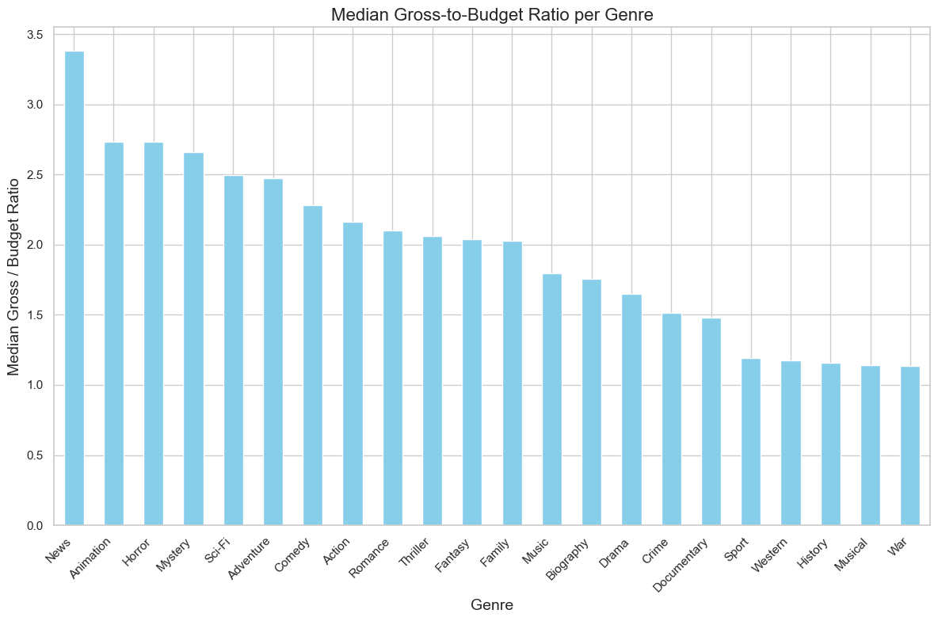
Gross/budget ratios per genre.

Slide 16
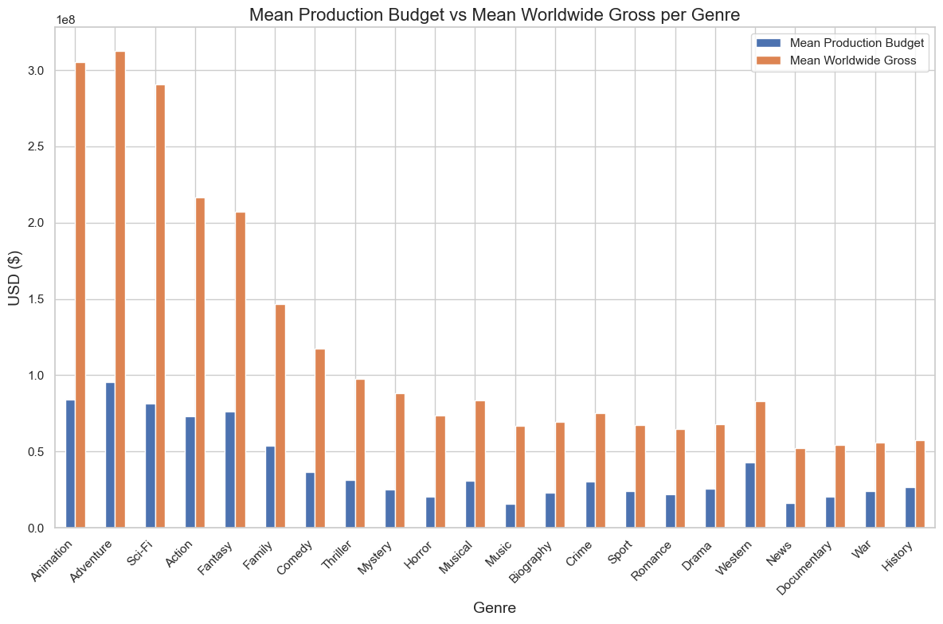
Business strategy recommendations.
Encourage Data-Driven Greenlighting.
We recommend that you leverage historical ROI data by genre, budget, and studio to guide investment decisions on which projects to greenlight—particularly those with proven high ROI profiles such as animation, adventure, and Sci-Fi.

Slide 17
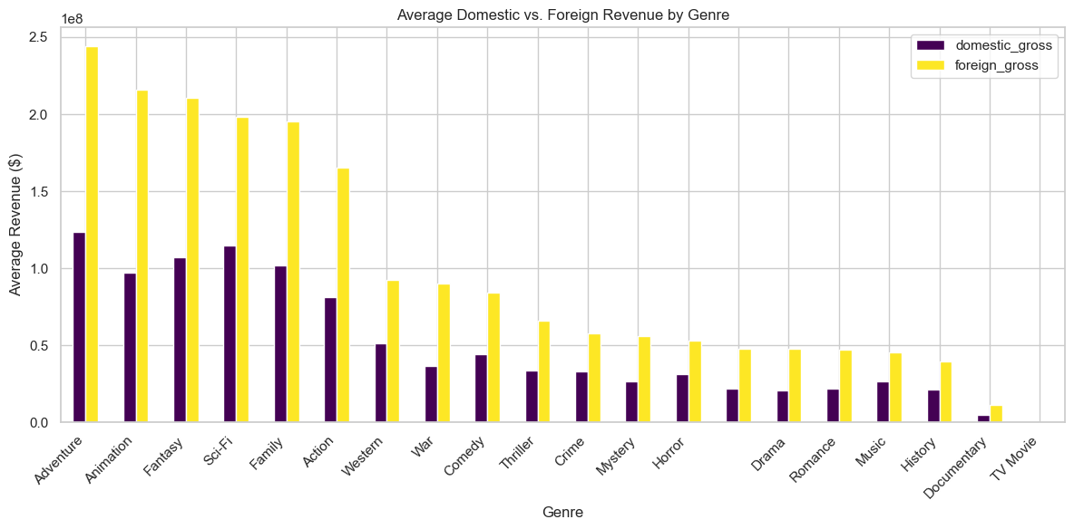
Strengthen International Distribution Early.
Capitalize on foreign gross potential by securing international partnerships and distribution channels in early stages of production.

Slide 18
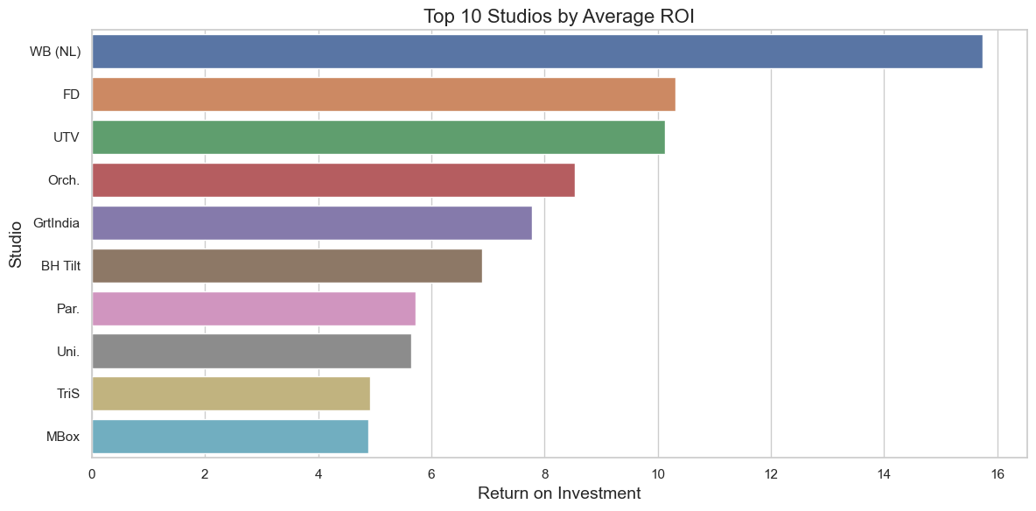
Optimize Studio Spending.
Benchmark top-performing studios by ROI rather than total gross to uncover spending inefficiencies and reallocate budgets more strategically.

Slide 19
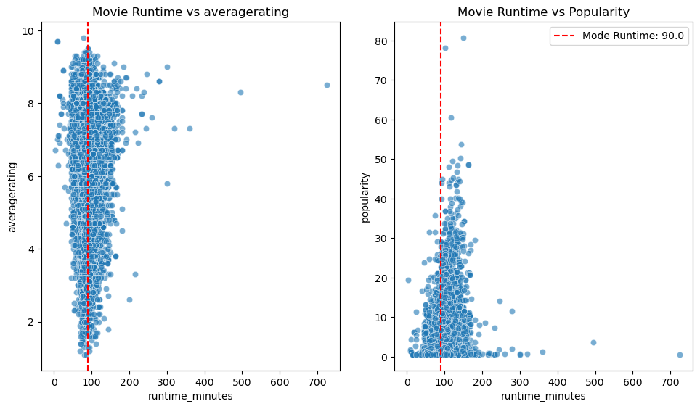
Runtime recommendations.
Runtime-ratings relationship.
We recommend that production teams prioritize films with runtimes between 90-120 minutes.
Our findings revealed that this is the industry’s "sweet spot" for balancing audience engagement, critical reception, and box office performance.

Slide 20
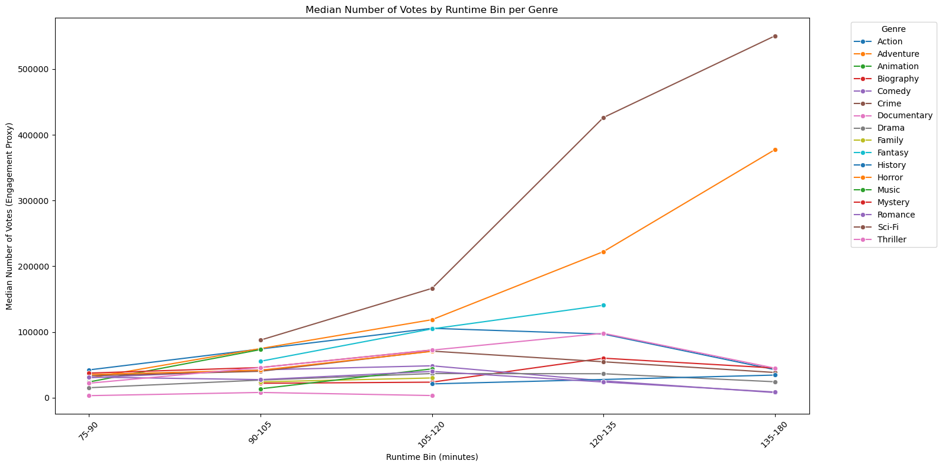
Genre-specific engagements.
We Strongly recommend the use of genre-specific benchmarks when planning film length.
- We found that;
Due to fan expectations, action / Drama / Sci-Fi films can tolerate slightly longer runtimes.
Comedies, thrillers, and animation should target tighter runtimes for better audience retention.

Slide 21
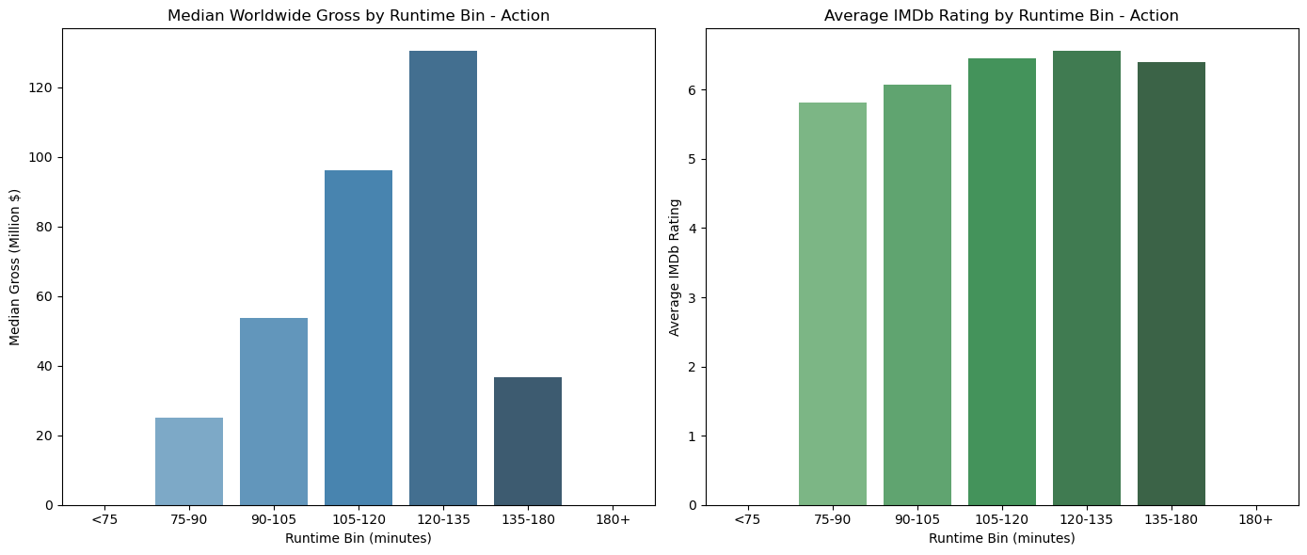
Worldwide gross by runtime and ratings.
To minimize audience drop-off and maximize repeat viewing, avoid extremes (films that are too short or excessively long).

Slide 22
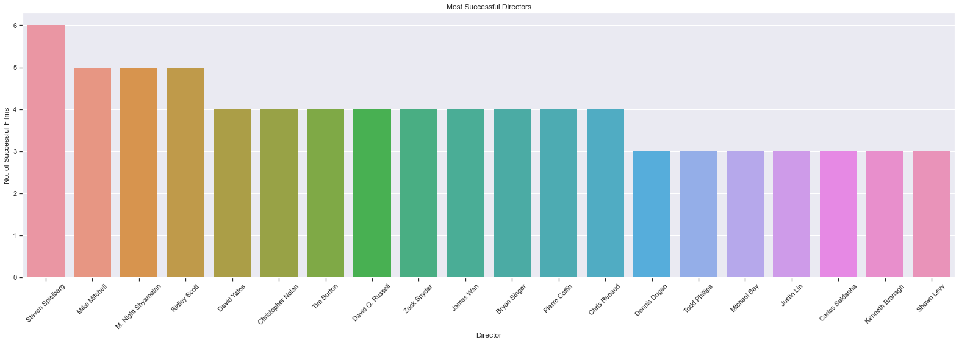
Talent recommendations.
Directors.
We recommend directors such as 'Steven Spielberg', 'Mike Mitchell', 'M. Night Shyamalan', 'Ridley Scott’, and 'Tim Burton’ be a part of the company’s production team. These are some of the directors who directed several high-revenue movies.

Slide 23
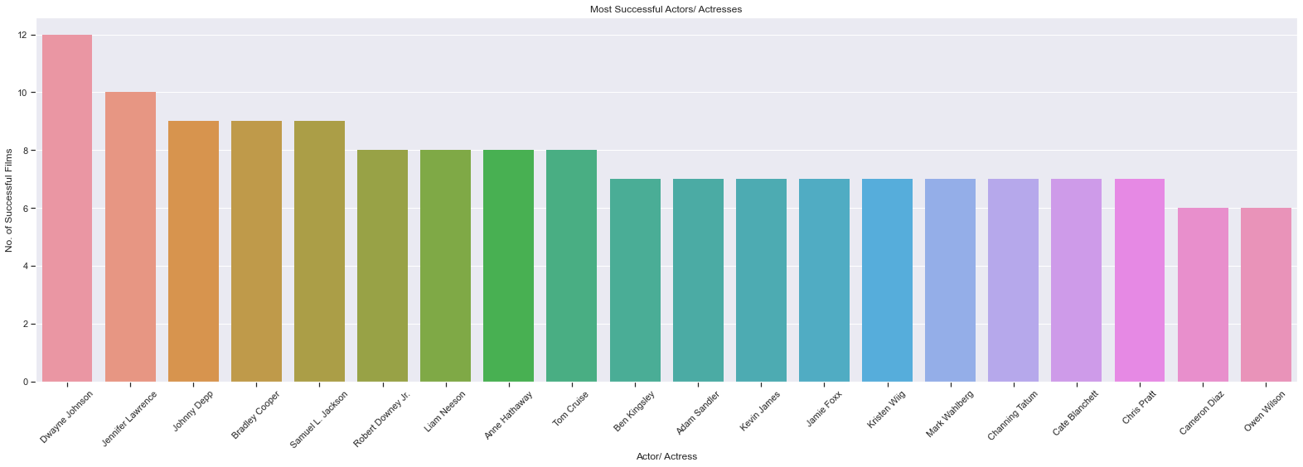
Actors.
We recommend hiring and including actors like 'Dwayne Johnson', 'Jennifer Lawrence', 'Johnny Depp', 'Bradley Cooper', 'Samuel L. Jackson', 'Robert Downey Jr.', 'Liam Neeson', 'Anne Hathaway', 'Tom Cruise’, and 'Ben Kingsley’, in the studio’s contents. These are some of the actors who appeared severally in high-earning films therefore cementing our beliefs that they have influence in the film industry.

Slide 24
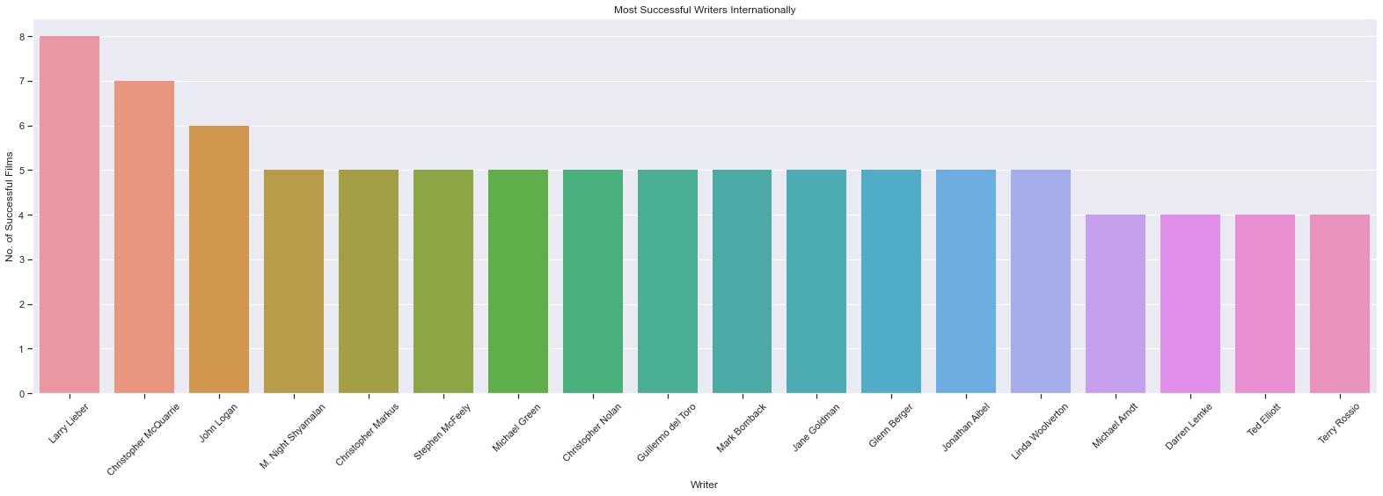
Writers.
After careful considerations, the team recommends ‘'Larry Lieber', 'Christopher McQuarrie', 'John Logan', 'M. Night Shyamalan', 'Christopher Markus’, and 'Stephen McFeely’ as the company’s playwright. Our analysis identified them as some of the most brilliant writers in the film industry with several of their movies topping the revenue charts.

Slide 25
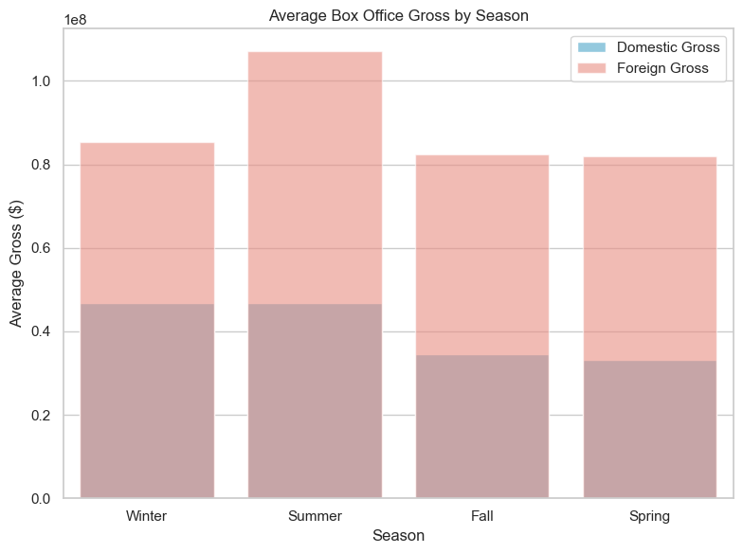
Release strategy and revenue optimization.
Best-Performing Release Seasons.
We recommend scheduling blockbuster releases during Summer to capitalize on peak cinema attendance.
We also recommend you target family-friendly and fantasy titles for Winter holidays when family audiences surge.
Additionally, use Spring and Fall as tactical slots for lower-budget or niche genre films where market competition is softer.

Slide 26
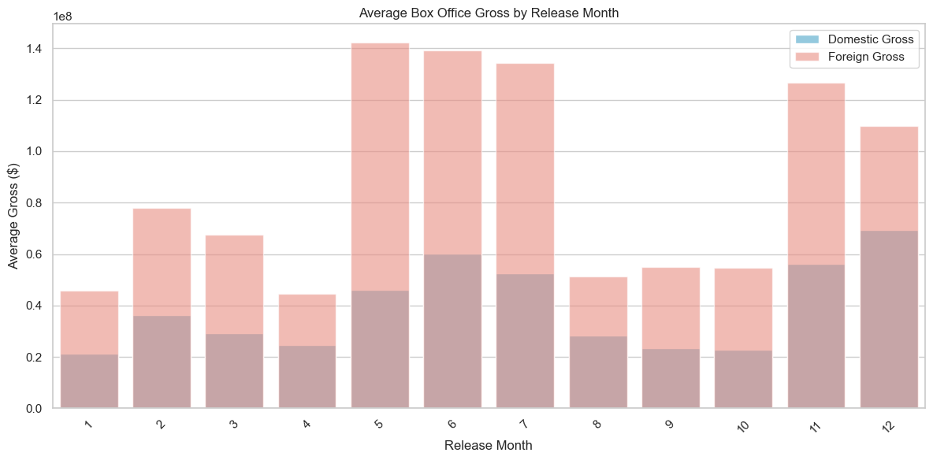
Best-performing release months.
In support of the previous recommendations, we add that the months of May, June, July, November and December are the best months to release the films.

Slide 27
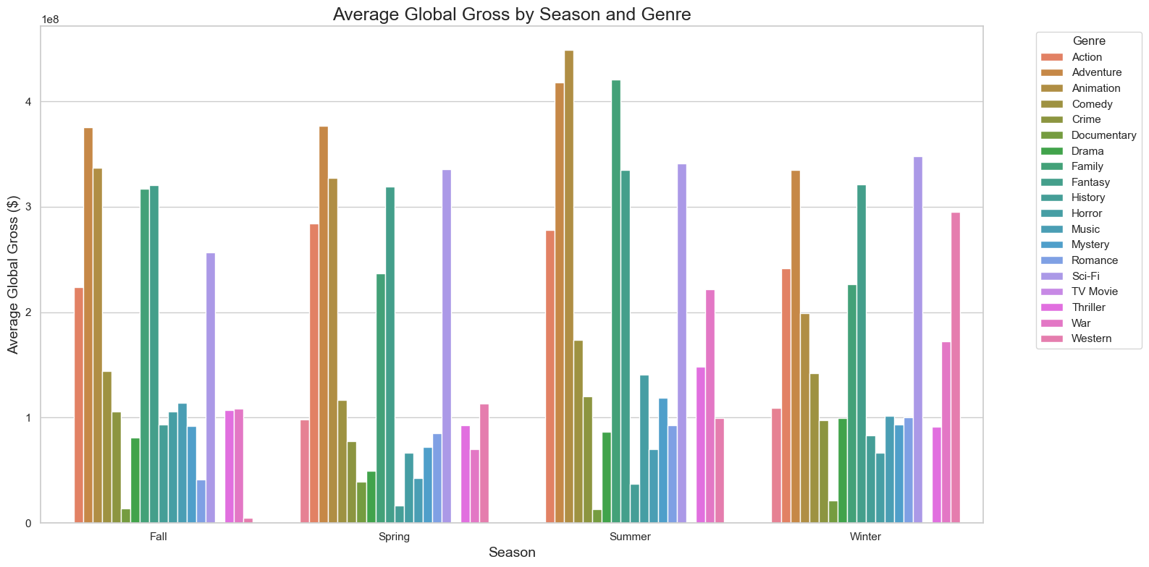
Lastly, we recommend that the company align release schedules with seasonal genre strengths;
Action/Adventure/Sci-Fi → Summer
Family/Fantasy → Winter Holidays.
Horror → October.
Drama/Romance → Fall
Plan season-specific marketing campaigns that play into seasonal moods and events (e.g. holiday-themed promotions, summer blockbuster hype).

Slide 28
Summary.
In launching the new studio, we recommend a balanced approach:
Focus on profitable genres while balancing with big-brand opportunities.
Encourage data-driven greenlighting, strengthen international distribution early and optimize studio spending.
Target optimal runtimes per genre.
Build teams with high-ROI actors, directors, and writers.
Diversify the portfolio to manage risk and drive consistent revenue.
Think globally - position films for international success.

Slide 29
Next steps.
Set specific objectives - Translate the recommendations to concrete goals.
Resource allocation - Estimate costs for development, production, marketing and distribution.
Project selection - Choose which concepts to pursue.
Workflow and timeline planning - Break projects into phases with deliverables.
Risk assessment & contingency planning - Identify risks and prepare backup plans.
Marketing and distribution planning - Define release strategies, target markets and campaign timelines and promotional partnerships.
Monitoring and KPIs - Decide how success will be tracked and set up dashboards or regular reporting routines.
29

Slide 30

Q & A session.

Slide 31






Thank you.
Wamuyu Gitonga
Team Lead
Vanessa Sandra
Natalie Wanjiku
Lilian Wangui
Feel free to email us at any of the email addresses below;
wamuyugitonga@gmail.com
veesandra30@gmail.com
samiellesimple@gmail.com
lilianwangui266@gmail.com
leemwa244@gmail.com
jnnjogu6@gmail.com
Leejay Mwakereti
John Njogu

